Slide 1
Scalable Deep Learning with Microsoft Cognitive Toolkit Cha Zhang, Prin. Researcher Emad Barsoum Sayan Pathak, Prin. ML Scientist
With many contributors:
A. Agarwal, E. Akchurin, E. Barsoum, C. Basoglu, G. Chen, S. Cyphers, W. Darling, J. Droppo, K. Deng, A. Eversole, B. Guenter, P. He, M. Hillebrand, X. Huang, Z. Huang, R. Hoens, V. Ivanov, A. Kamenev, N. Karampatziakis, P. Kranen, O. Kuchaiev, W. Manousek, C. Marschner, A. May, B. Mitra, O. Nano, G. Navarro, A. Orlov, M. Radmilac, A. Reznichenko, P. Parthasarathi, S. Pathak, B. Peng, A. Reznichenko, W. Richert, F. Seide, M. Seltzer, M. Slaney, A. Stolcke, T. Will, H. Wang, Z. Wang, W. Xio. Yao, D. Yu, C. Zhang, Y. Zhang, G. Zweig

Slide 2
Tutorial Agenda

Slide 3
Agenda
Introduction (15 min) (cz)
What is Cognitive toolkit
Why Cognitive Toolkit
Basic operations (25 min) (sp)
Data reading and augmentations, Modeling (MLP, CNN, RNN), Training-Test-Eval workflow
Image application: (50 min) (eb/cz)
Inception, Resnet, Fast/Faster R-CNN, Pixel CNN, Emotion, Neural style
Video application: (40 min) (eb)
Action classification and detection

Slide 4
Agenda
Break (20 min)
Parallel training: (40 min) (cz)
1-bit SGD, Block momentum, variable sized mini-batch
Fast binarized evaluation (10 min) (sp)
Reinforcement learning in simulated environment (50 min) (eb ->sp)
Conclusion / Roadmap / Q&A (10 min) (cz / eb / sp)

Slide 5
What is Cognitive Toolkit Architecture Flexibity and Scalability
Cha

Slide 6

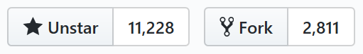
Intro - Microsoft Cognitive Toolkit (formerly CNTK)
Microsoft’s open-source deep-learning toolkit
https://github.com/Microsoft/CNTK
Created by Microsoft Speech researchers (Dong Yu et al.) in 2012, “Computational Network Toolkit”
On GitHub since Jan 2016 under MIT license
Renamed “Cognitive Toolkit”
Community contributions e.g. from MIT, Stanford and NVidia

Slide 7
Microsoft Cognitive Toolkit
Runs over 80% Microsoft internal DL workload
1st-class on Linux and Windows, docker support
New in GA:
Keras backend support (Beta)
Java support, Spark support
Model compression (Fast binarized evaluation)

Slide 8
Cognitive Other Benefits
Python and C++ API
Mostly implemented in C++
Low level + high level Python API
Extensibility
User functions and learners in pure Python
Readers
Distributed, highly efficient built-in data readers
Internal == External
Details:
https://docs.microsoft.com/en-us/cognitive-toolkit/reasons-to-switch-from-tensorflow-to-cntk

Slide 9
Cognitive Toolkit – The Fastest Toolkit
Caffe: 1.0rc5(39f28e4)
CNTK: 2.0 Beta10(1ae666d)
MXNet: 0.93(32dc3a2)
TensorFlow: 1.0(4ac9c09)
Torch: 7(748f5e3)
http://dlbench.comp.hkbu.edu.hk/
Benchmarking by HKBU, Version 8
Single Tesla K80 GPU, CUDA: 8.0 CUDNN: v5.1
 | Caffe | Cognitive Toolkit | MxNet | TensorFlow | Torch
FCN5 (1024) | 55.329ms | 51.038ms | 60.448ms | 62.044ms | 52.154ms
AlexNet (256) | 36.815ms | 27.215ms | 28.994ms | 103.960ms | 37.462ms
ResNet (32) | 143.987ms | 81.470ms | 84.545ms | 181.404ms | 90.935ms
LSTM (256) (v7 benchmark) | - | 43.581ms (44.917ms) | 288.142ms (284.898ms) | - (223.547ms) | 1130.606ms (906.958ms)

Slide 10
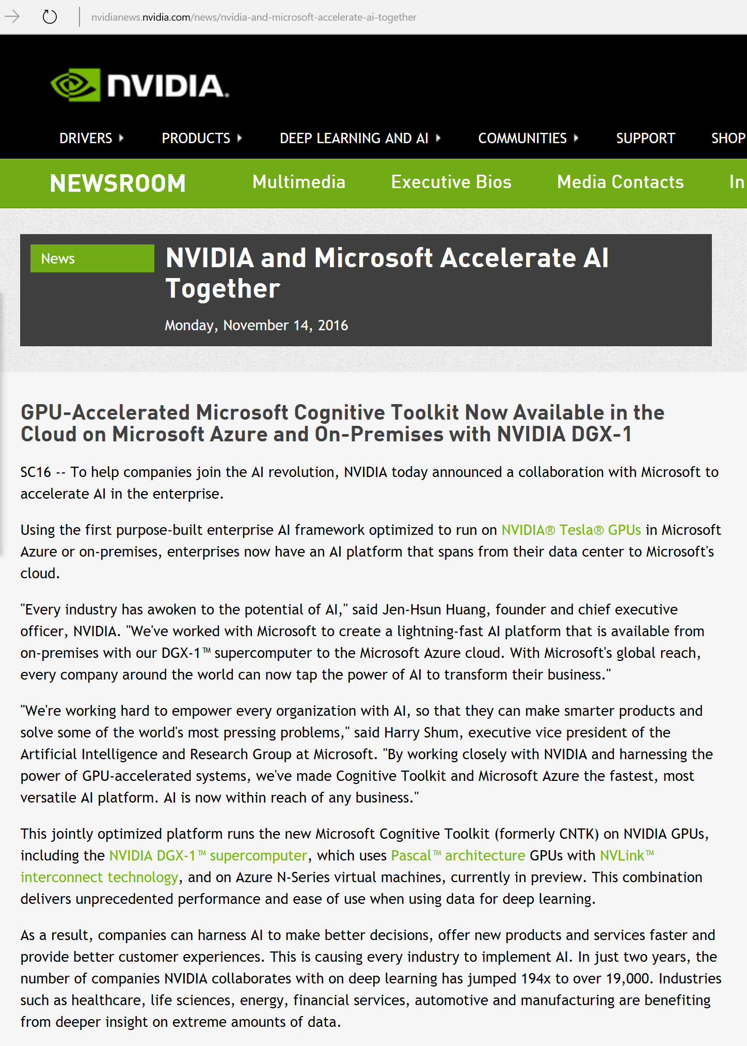
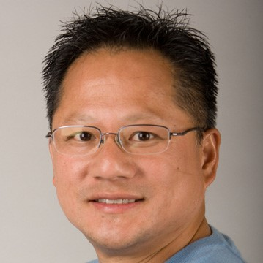
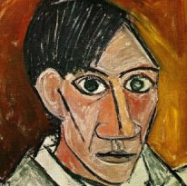
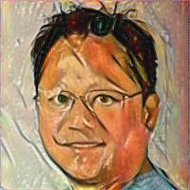
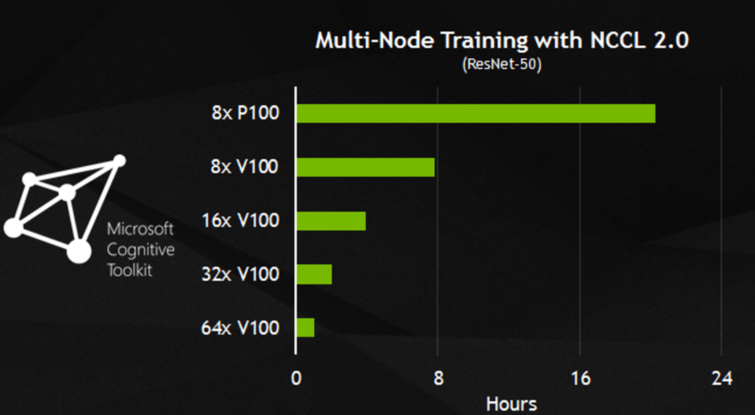
Superior performance
Notes:
At super computing conference 2016 in Salt Lake City, NVIDIA announced deep partnership with Microsoft, to deliver AI to businesses by leveraging speed and scalability powered by Cognitive Toolkit.

Slide 11
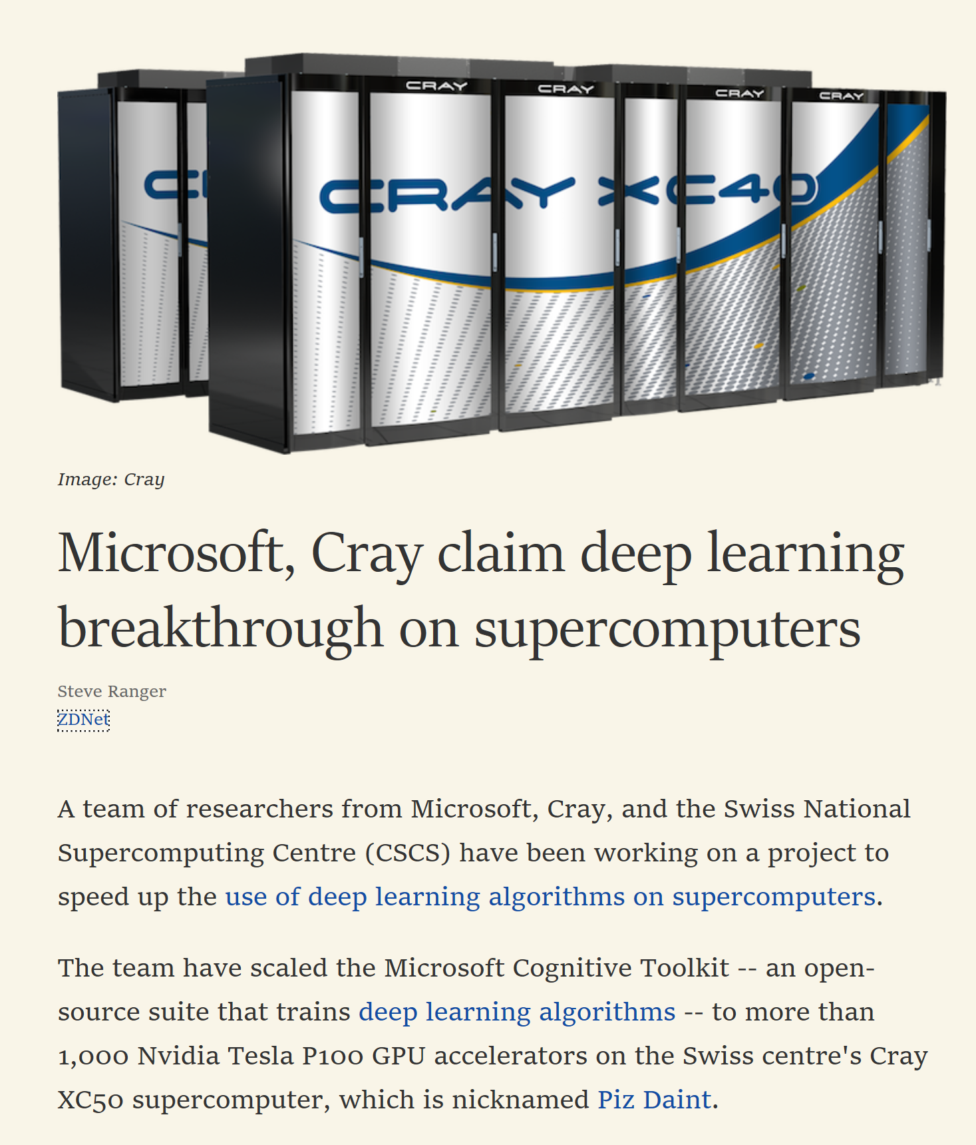
Scalability

Slide 12
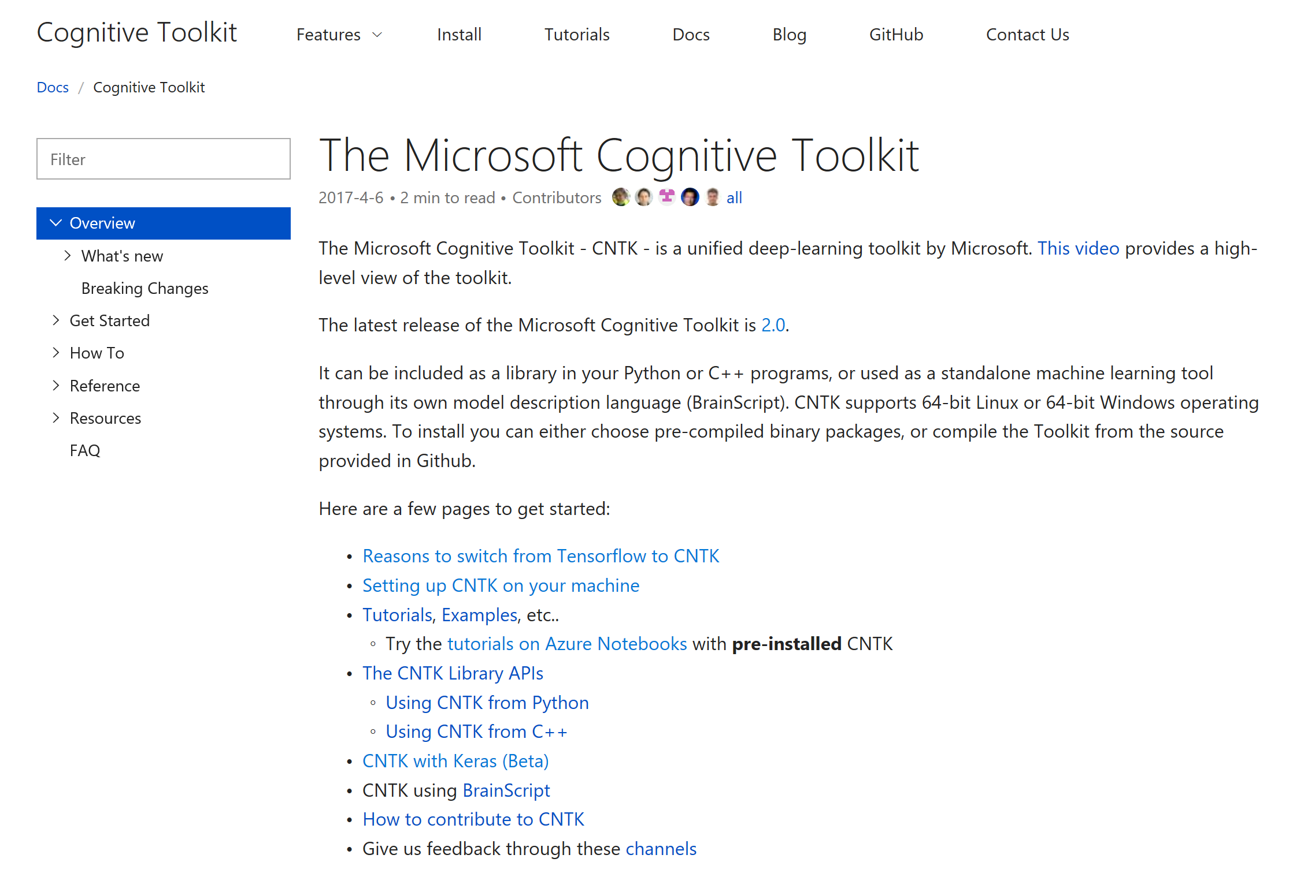
Where to begin?
GitHub: https://github.com/Microsoft/CNTK/wiki
Docs: https://docs.microsoft.com/en-us/cognitive-toolkit/
Seek help on Stack Overflow:
http://stackoverflow.com/search?q=cntk (please add cntk tag)

Slide 13
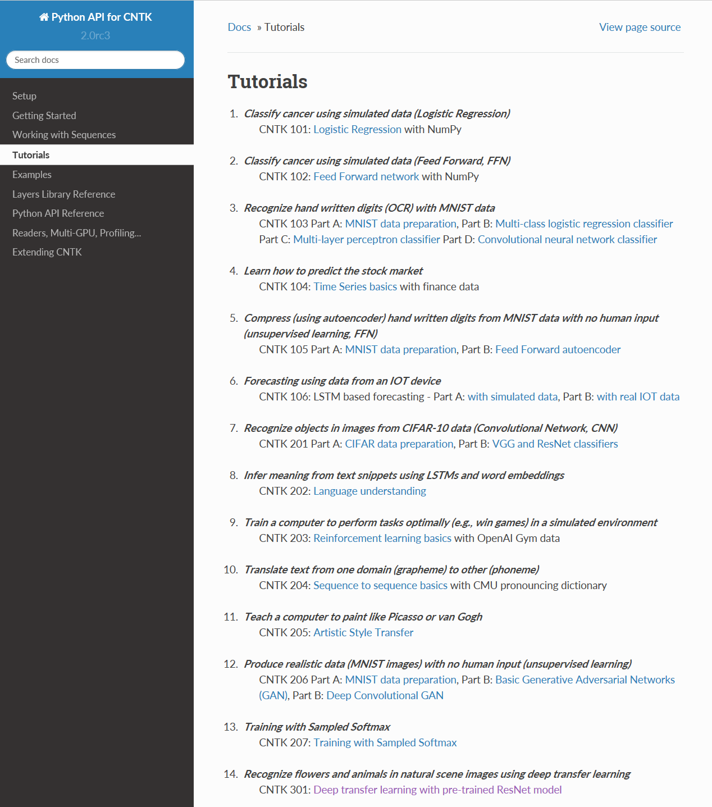
Where to begin?
Tutorials:
https://www.cntk.ai/pythondocs/tutorials.html

Slide 14
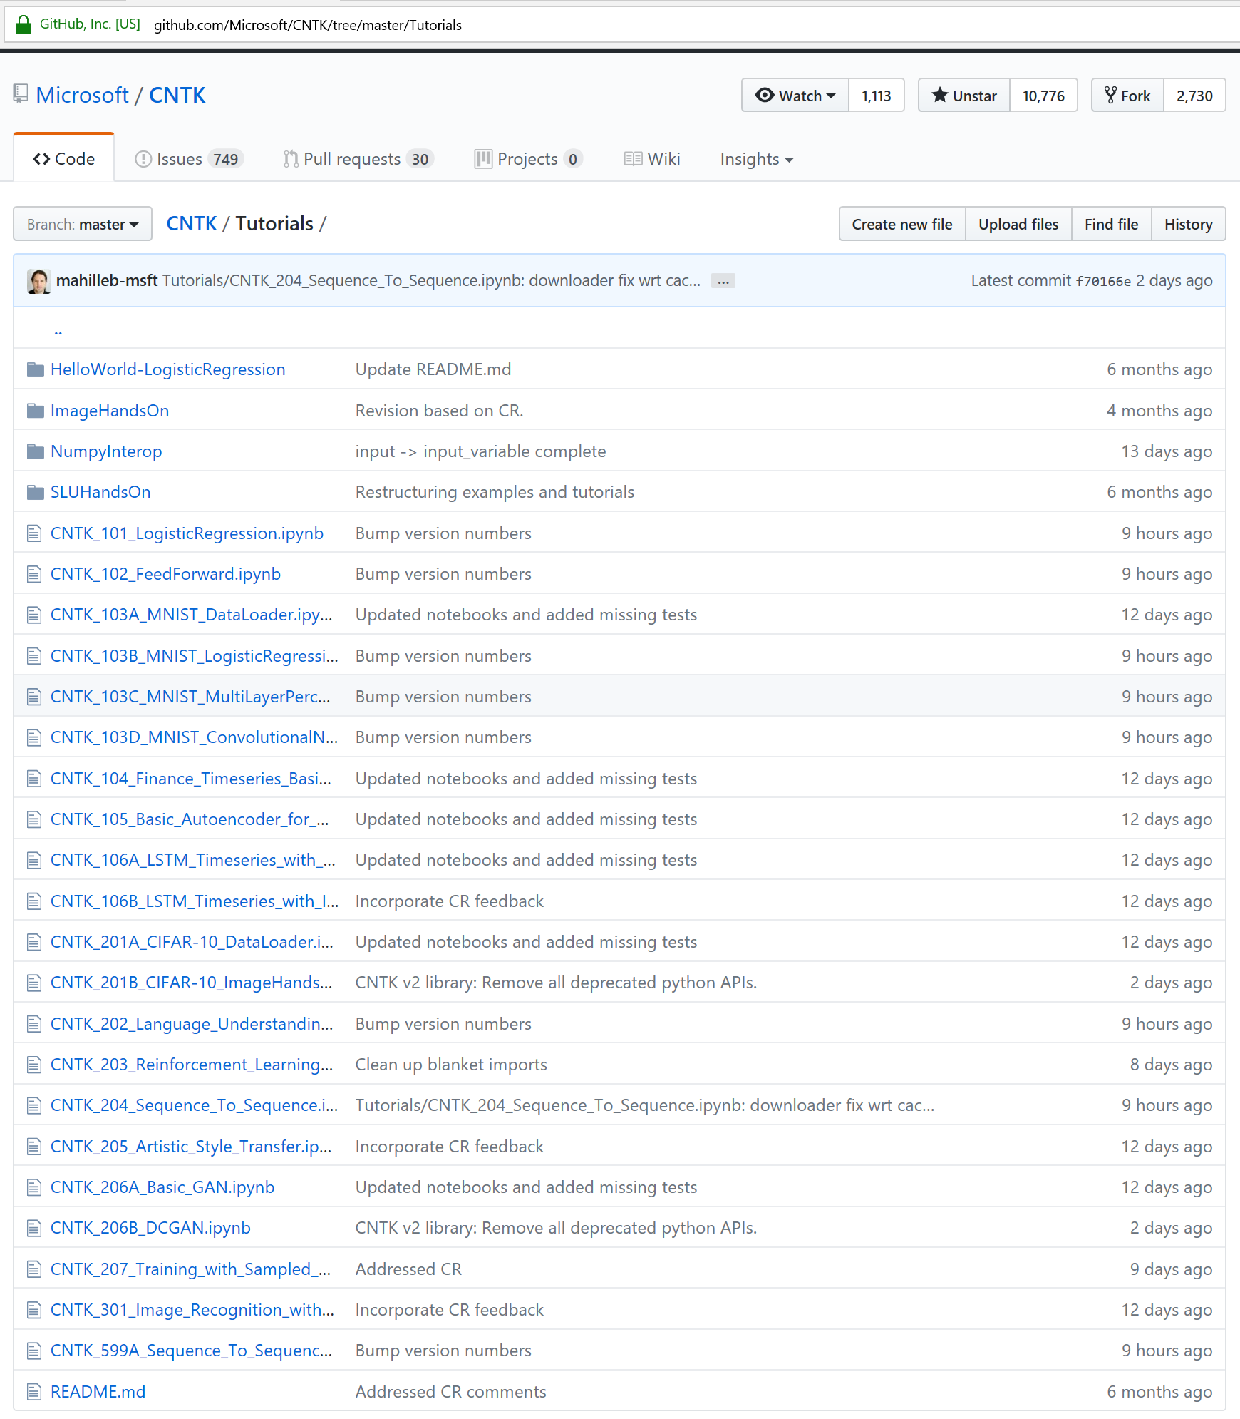
Where to begin?
Tutorials:
https://github.com/Microsoft/CNTK/tree/master/Tutorials

Slide 15
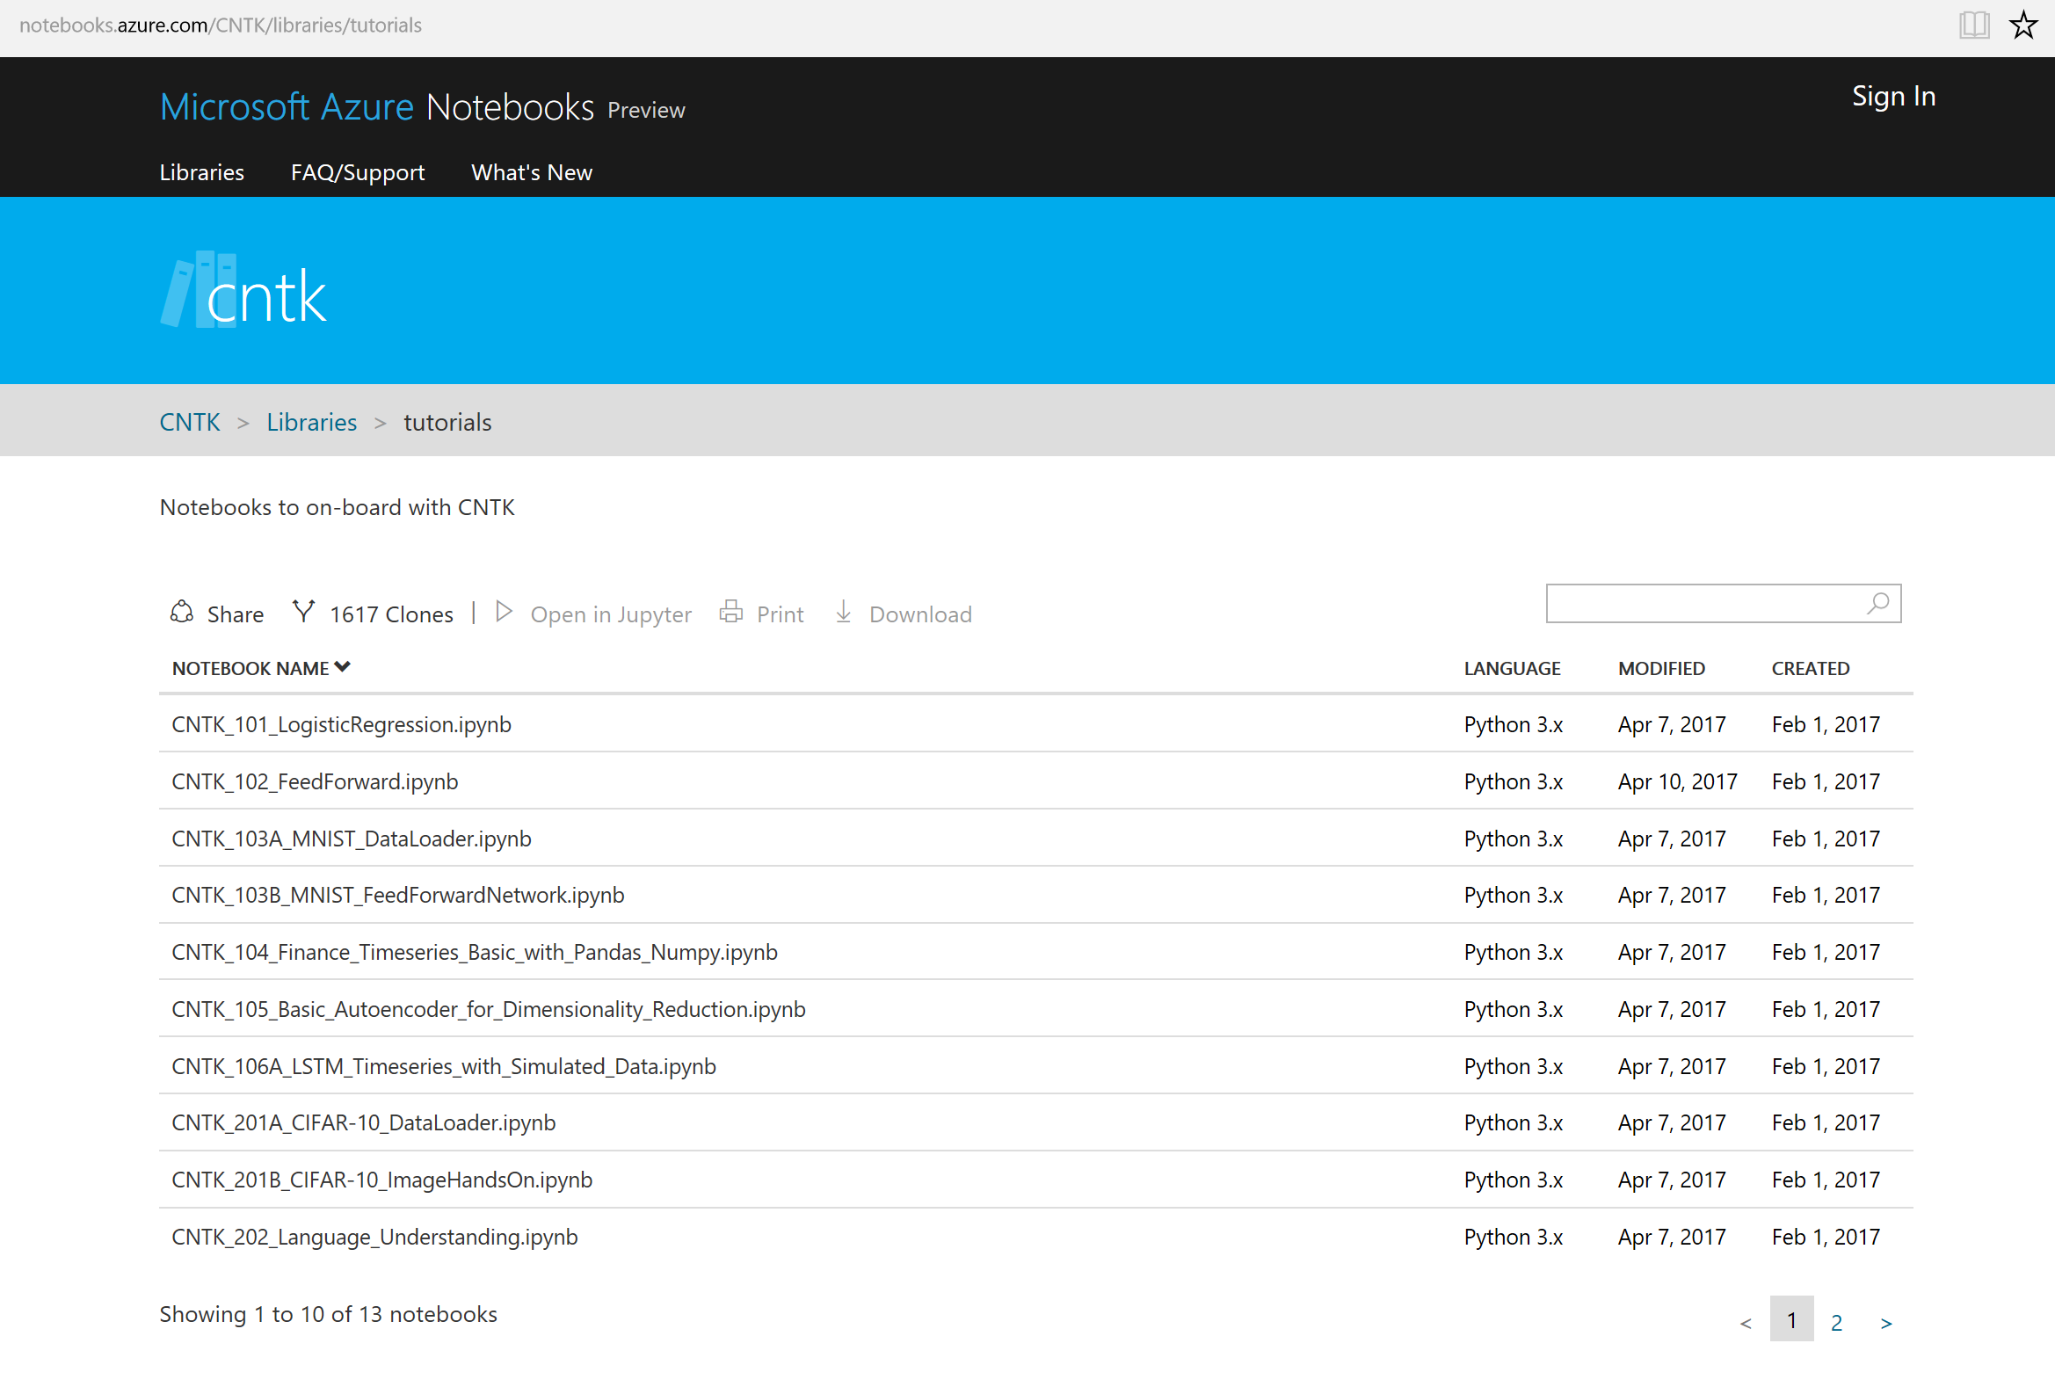
Where to begin?
Azure Notebooks: Try for free pre-hosted
https://notebooks.azure.com/cntk/libraries/tutorials

Slide 16


Slide 17
Toolkit Basics: Data Readers (with Augmentation) Modeling components (MLP/CNN/RNN) Train-Test-Eval workflow
Sayan

Slide 18
CNTK workflow
Script configure and executes through CNTK Python APIs…
reader
• minibatch source • task-specific deserializer
• automatic randomization
• distributed reading
network
• model function • criterion function • CPU/GPU execution engine
• packing, padding
trainer
• SGD (momentum, Adam, …)
• minibatching
corpus
model

Slide 19
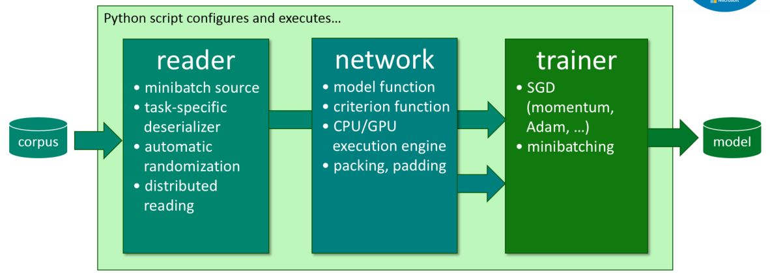
As easy as 1-2-3
from cntk import *
# reader
def create_reader(path, is_training):
...
# network
def create_model_function():
...
def create_criterion_function(model):
...
# trainer (and evaluator)
def train(reader, model):
...
def evaluate(reader, model):
...
# main function
model = create_model_function()
reader = create_reader(..., is_training=True)
train(reader, model)
reader = create_reader(..., is_training=False)
evaluate(reader, model)
Notes:
note: emphasize $root$ to make it come out very clearly that variables inside can be overridden/tasks can be parameterized from the command-line

Slide 20
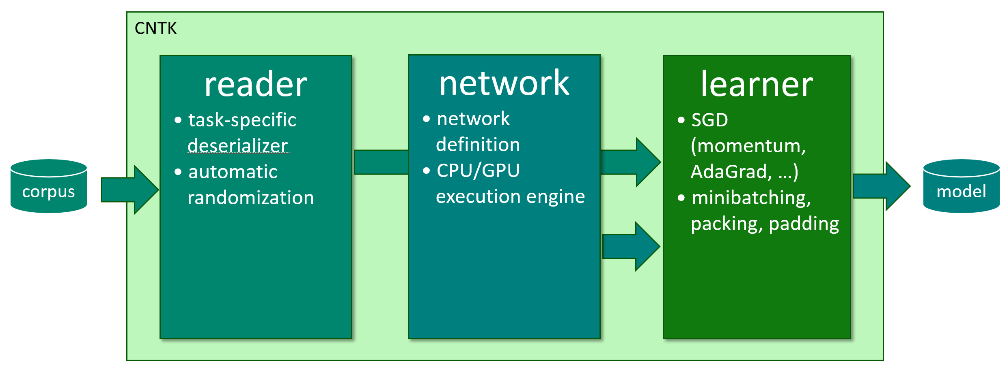
Workflow
prepare data
configure reader, network, learner (Python)
train:
mpiexec --np 16 --hosts server1,server2,server3,server4 \ python my_cntk_script.py
Notes:
very simple to parallelize

Slide 21
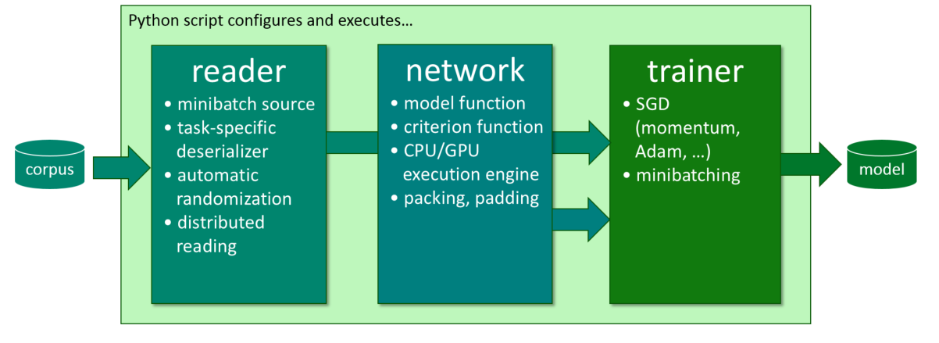
Prepare data: reader
def create_reader(map_file, mean_file, is_training):
# image preprocessing pipeline
transforms = [
ImageDeserializer.crop(crop_type='Random', ratio=0.8, jitter_type='uniRatio')
ImageDeserializer.scale(width=image_width, height=image_height, channels=num_channels, interpolations='linear'),
ImageDeserializer.mean(mean_file)
]
# deserializer
return MinibatchSource(ImageDeserializer(map_file, StreamDefs(
features = StreamDef(field='image', transforms=transforms), '
labels = StreamDef(field='label', shape=num_classes)
)), randomize=is_training, epoch_size = INFINITELY_REPEAT if is_training else FULL_DATA_SWEEP)
Notes:
(just explain: (1) deserialization incl. IDeserializer and (2) auto-randomization)

Slide 22
Prepare data: reader
def create_reader(map_file, mean_file, is_training):
# image preprocessing pipeline
transforms = [
ImageDeserializer.crop(crop_type='Random', ratio=0.8, jitter_type='uniRatio')
ImageDeserializer.scale(width=image_width, height=image_height, channels=num_channels, interpolations='linear'),
ImageDeserializer.mean(mean_file)
]
# deserializer
return MinibatchSource(ImageDeserializer(map_file, StreamDefs(
features = StreamDef(field='image', transforms=transforms), '
labels = StreamDef(field='label', shape=num_classes)
)), randomize=is_training, epoch_size = INFINITELY_REPEAT if is_training else FULL_DATA_SWEEP)
automatic on-the-fly randomization important for large data sets
readers compose, e.g. image → text caption
Notes:
(just explain: (1) deserialization incl. IDeserializer and (2) auto-randomization)

Slide 23
Distributed training
prepare data
configure reader, network, learner (Python)
train: --distributed!
mpiexec --np 16 --hosts server1,server2,server3,server4 \ python my_cntk_script.py
Notes:
very simple to parallelize

Slide 24
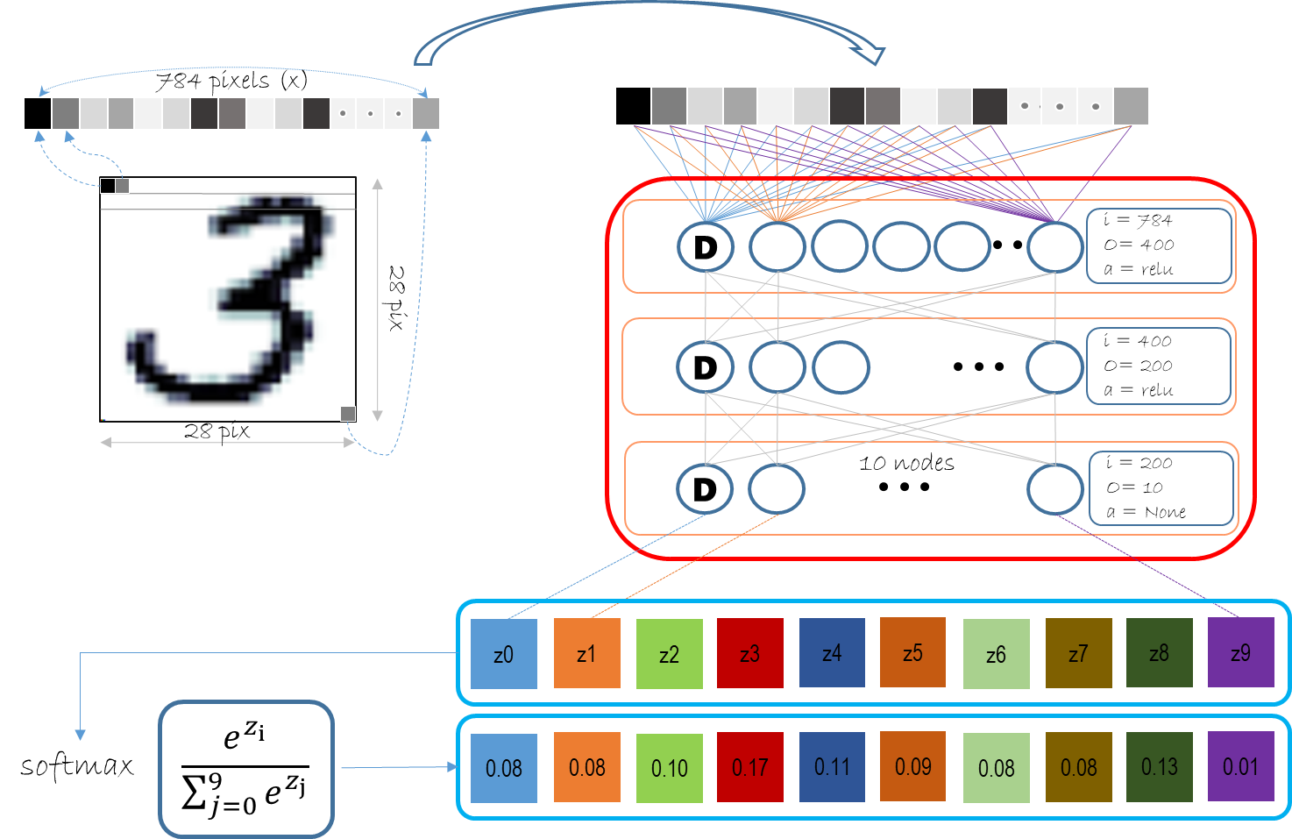
Multi-layer perceptron
z = model(X):
h1 = Dense(400, act = relu)(X)
h2 = Dense(200, act = relu)(h1)
r = Dense(10, act = None)(h2)
return r
Model
Loss
cross_entropy_with_softmax(z,Y)

Slide 25

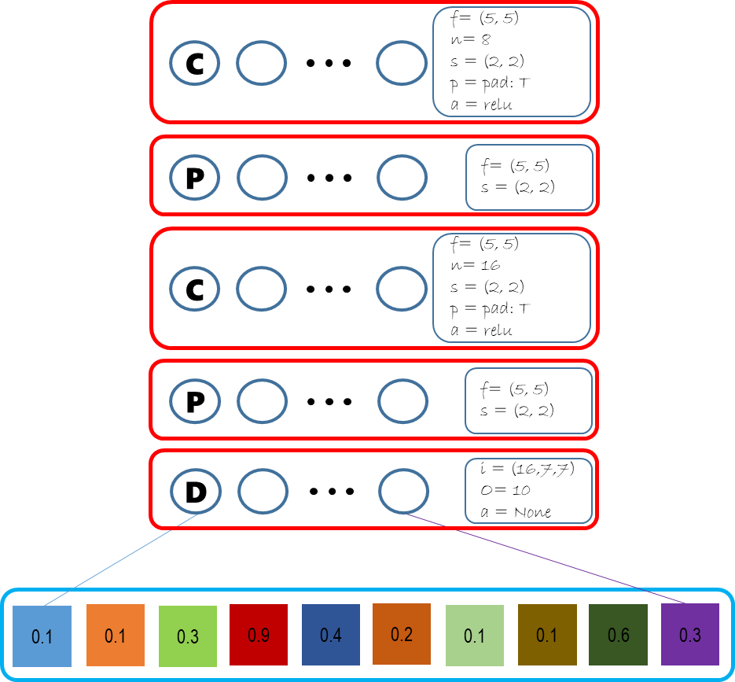
Convolutional Neural Network
z = model(X):
h = Convolution2D((5,5),filt=8, …)(X)
h = MaxPooling(…)(h)
h = Convolution2D ((5,5),filt=16, …)((h)
h = MaxPooling(…)(h)
r = Dense(output_classes, act= None)(h)
return r
28 pix
Model
28 pix

Slide 26
Recurrence Neural Network
z = model(X):
h = Convolution2D((5,5),filt=8, …)(X)
h = MaxPooling(…)(h)
h = Convolution2D ((5,5),filt=16, …)((h)
h = MaxPooling(…)(h)
r = Dense(output_classes, act= None)(h)
return r
28 pix
Model
28 pix

Slide 27

Sequences (many to many + 1:1)
Problem: Tagging entities in Air Traffic Controller (ATIS) data
o
From_city
o
To_city
o
Date
Rec
Rec
Rec
Rec
Rec
Rec
show
burbank
to
seattle
flights
tomorrow
http://karpathy.github.io/2015/05/21/rnn-effectiveness/
Notes:
Say that word gets magically transformed into a numeric vector

Slide 28
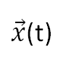
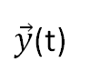
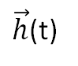
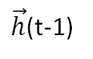
Model
$\vec{y}$(t)
Class label
$\vec{y}$(t)
D
D
i = 300
O= 129
a = sigmoid
$\vec{h}$(t-1)
i = 150
O= 300
$\vec{h}$(t)
L
L
E
i = 943
O= 150
E
$\vec{x}$(t)
Text token
$\vec{x}$(t)
0
0
1
0
1 x 943
0
0
1
0
Notes:
Generating word embedding via techniques like GloVe and Word2vec are popular. However, this is beyond the scope of this course.

Slide 29
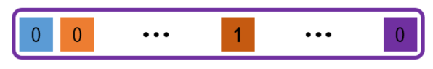
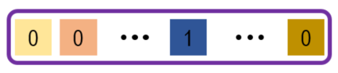
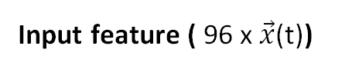
Train Workflow
Input feature ( 96 x $\vec{x}$(t))
z = model():
return
Sequential([
Embedding(emb_dim=150),
Recurrence(LSTM(hidden_dim=300),
go_backwards=False),
Dense(num_labels = 129)
])
#1
t₁
.
t₂₃
#2
t₁
.
t₁₅
#3
t₁
.
t₉
#96
t₁
.
t₁₂
ATIS
Train
96 samples
(mini-batch)
One-hot encoded
Label
(Y: 96 x 129/sample
Or word in sequence)
Loss
cross_entropy_with_softmax(z,Y)
Error
classification_error(z,Y)
Trainer(model, (loss, error), learner)
Trainer.train_minibatch({X, Y})
Learner
Adam, adagrad etc, are solvers to estimate

Slide 30
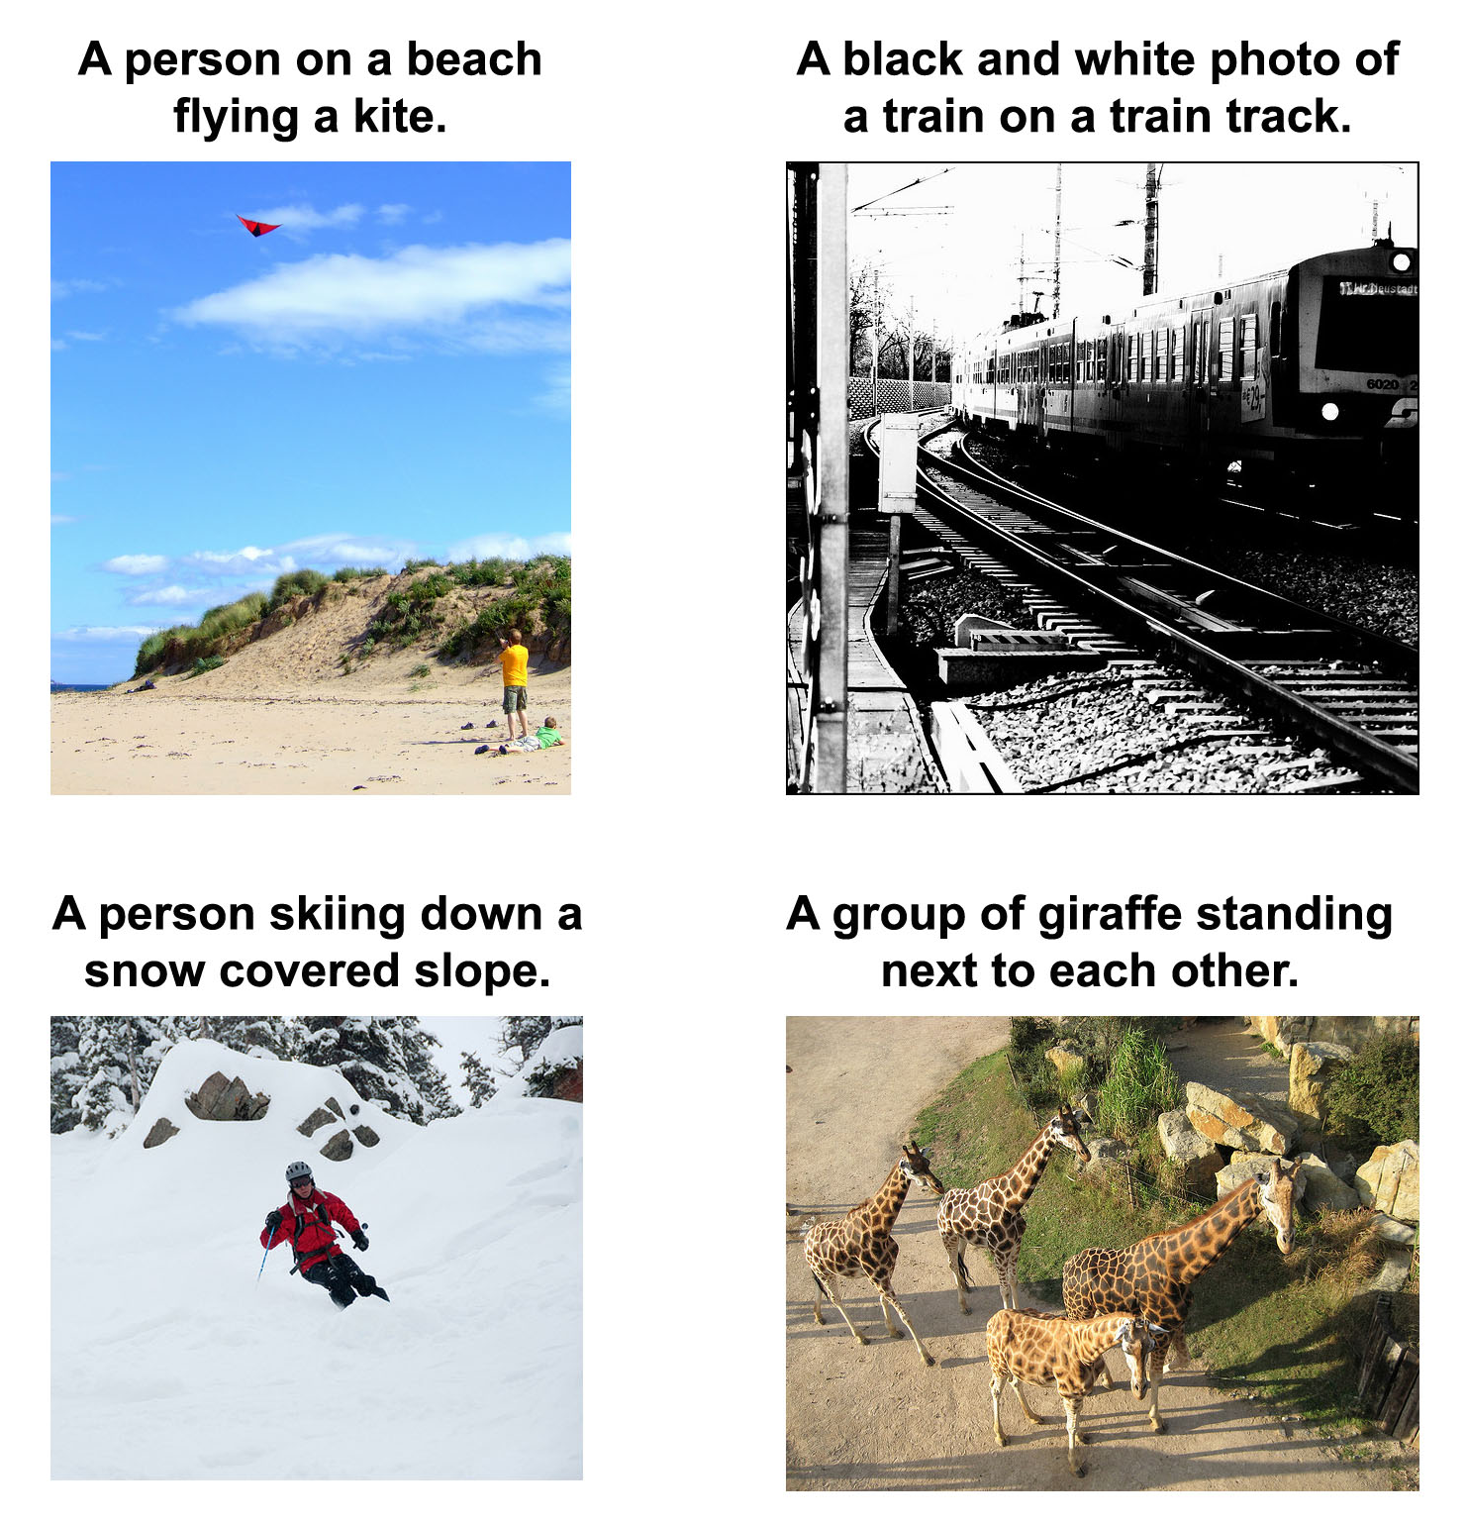
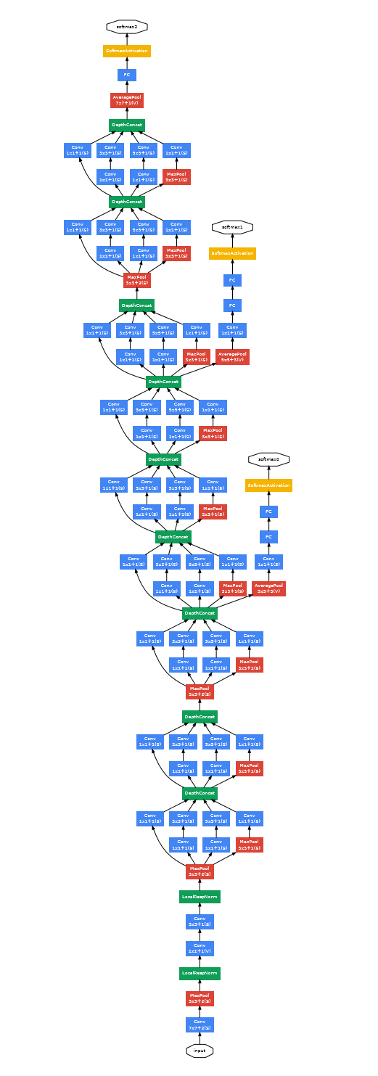
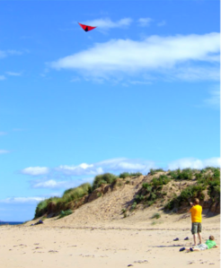
Sequences (one to many)
a
person
a
kite
Rec
Rec
Rec
Rec
http://karpathy.github.io/2015/05/21/rnn-effectiveness/
Vinyals et al (https://arxiv.org/abs/1411.4555)

